Slide 1
Supervised Vs Unsupervised learning
Itay Hazan

Slide 2
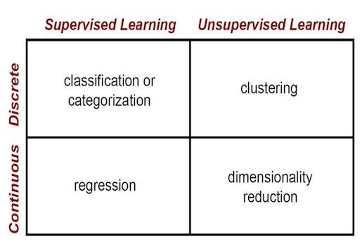
The Main Difference
Supervised Learning
Input: data + labels
Goal: understand why samples are labeled the way they are.
Unsupervised Learning
Input: data
Goal: understand the hidden structure within the data (“God’s distribution”).

Slide 3
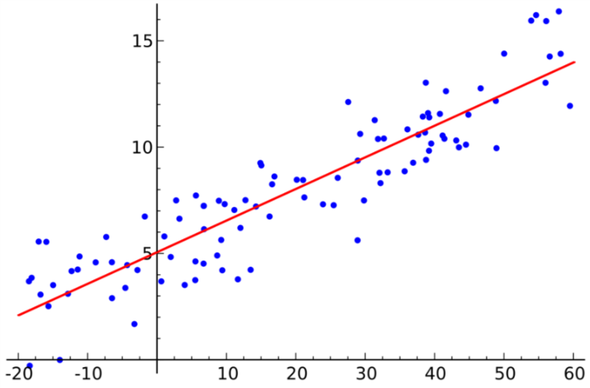
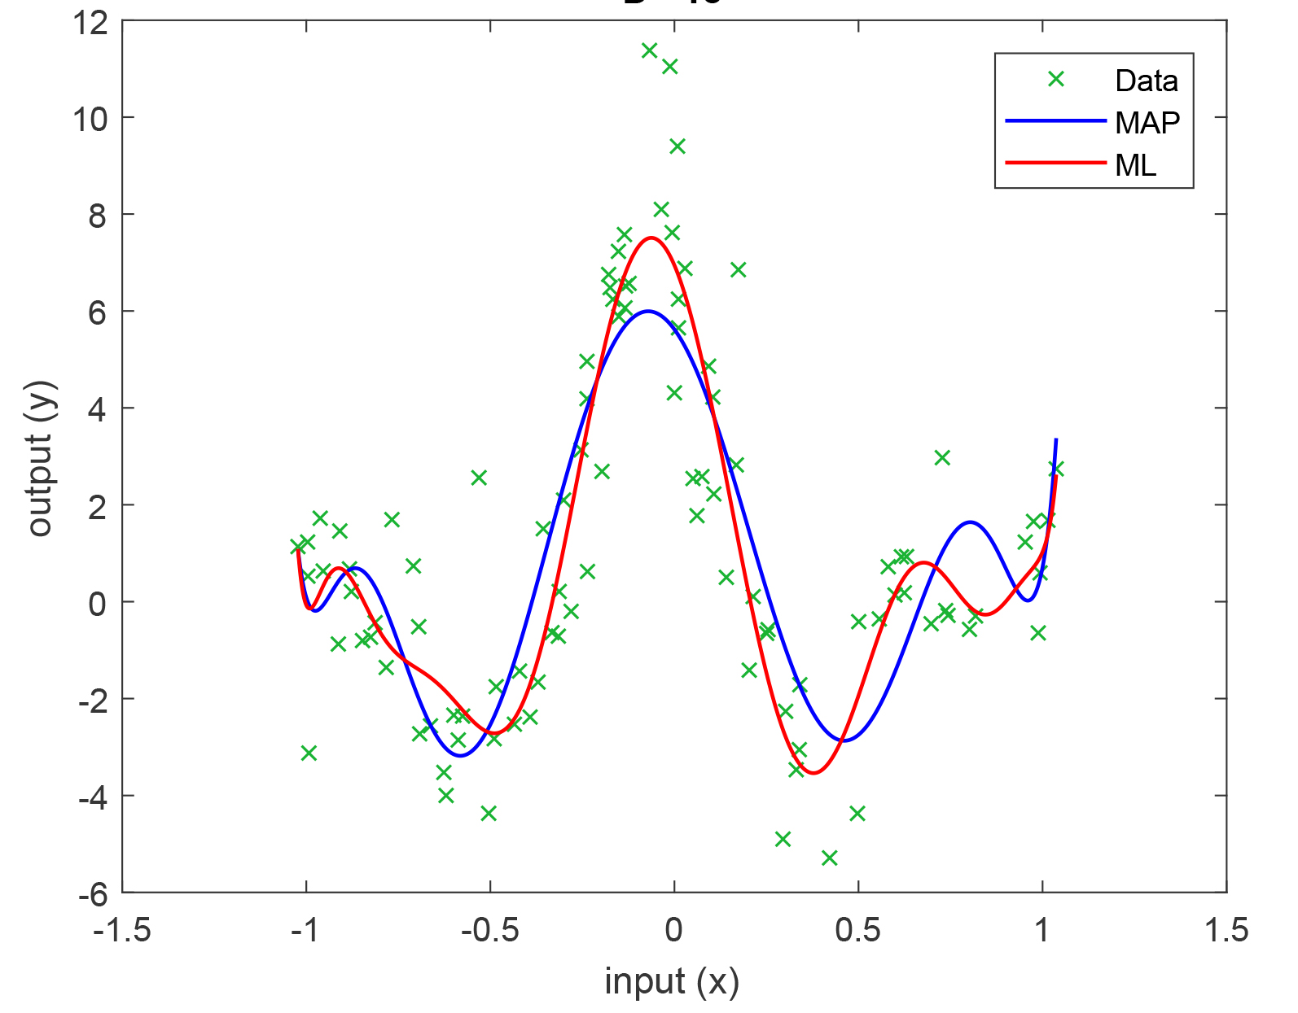
Supervised Learning: Regression

Slide 4
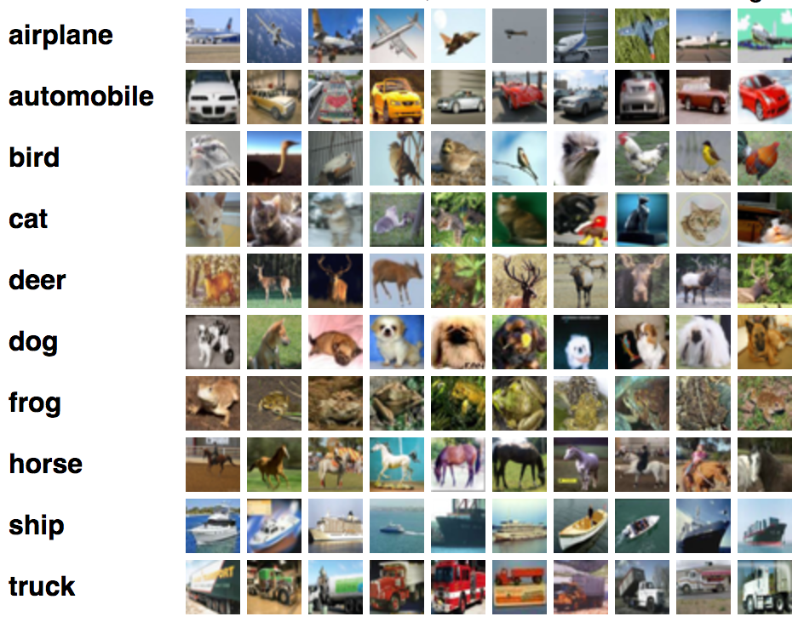

Supervised Learning: Classification
Step 1: Learn
Step 2: Generalize
Cat
[Image taken from CIFAR10 dataset]

Slide 5
Supervised Learning: Classification

Slide 6
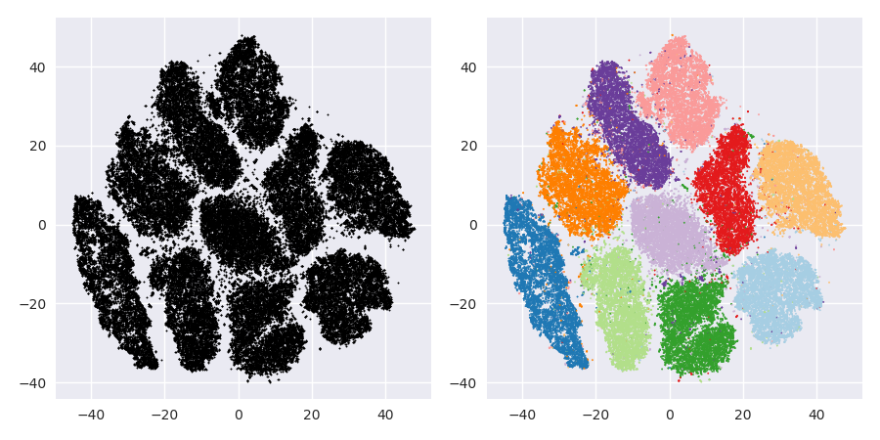
Unsupervised Learning: Clustering

Slide 7
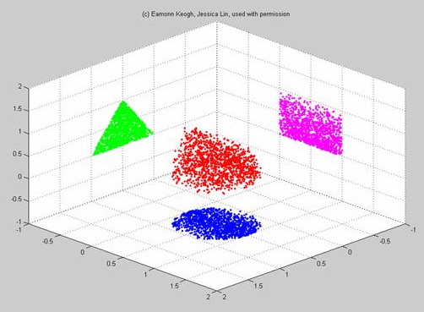
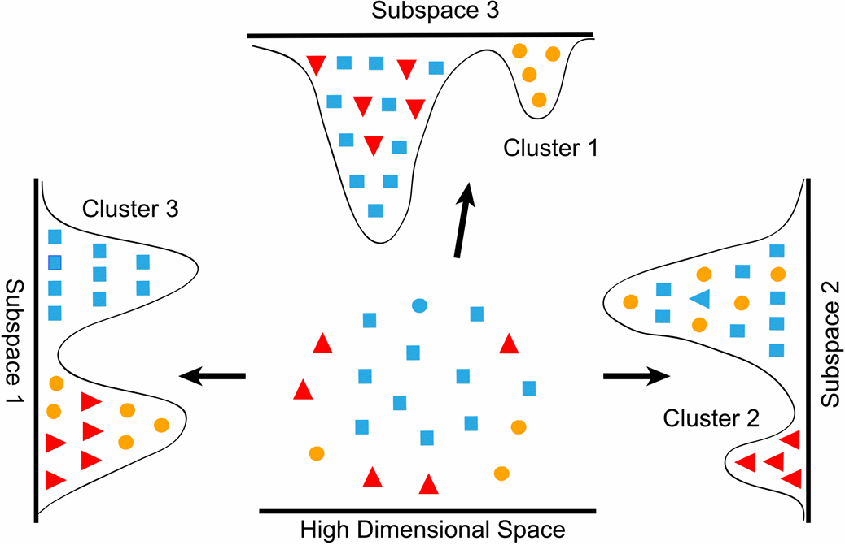
Unsupervised Learning: Dimensionality Reduction

